Slide 1


Biostats and Big Data
Lecture 13
Lecture 13
Softwares and programming languages
CHOONG-WAN WOO | COCOAN lab | http://cocoanlab.github.io

Slide 2
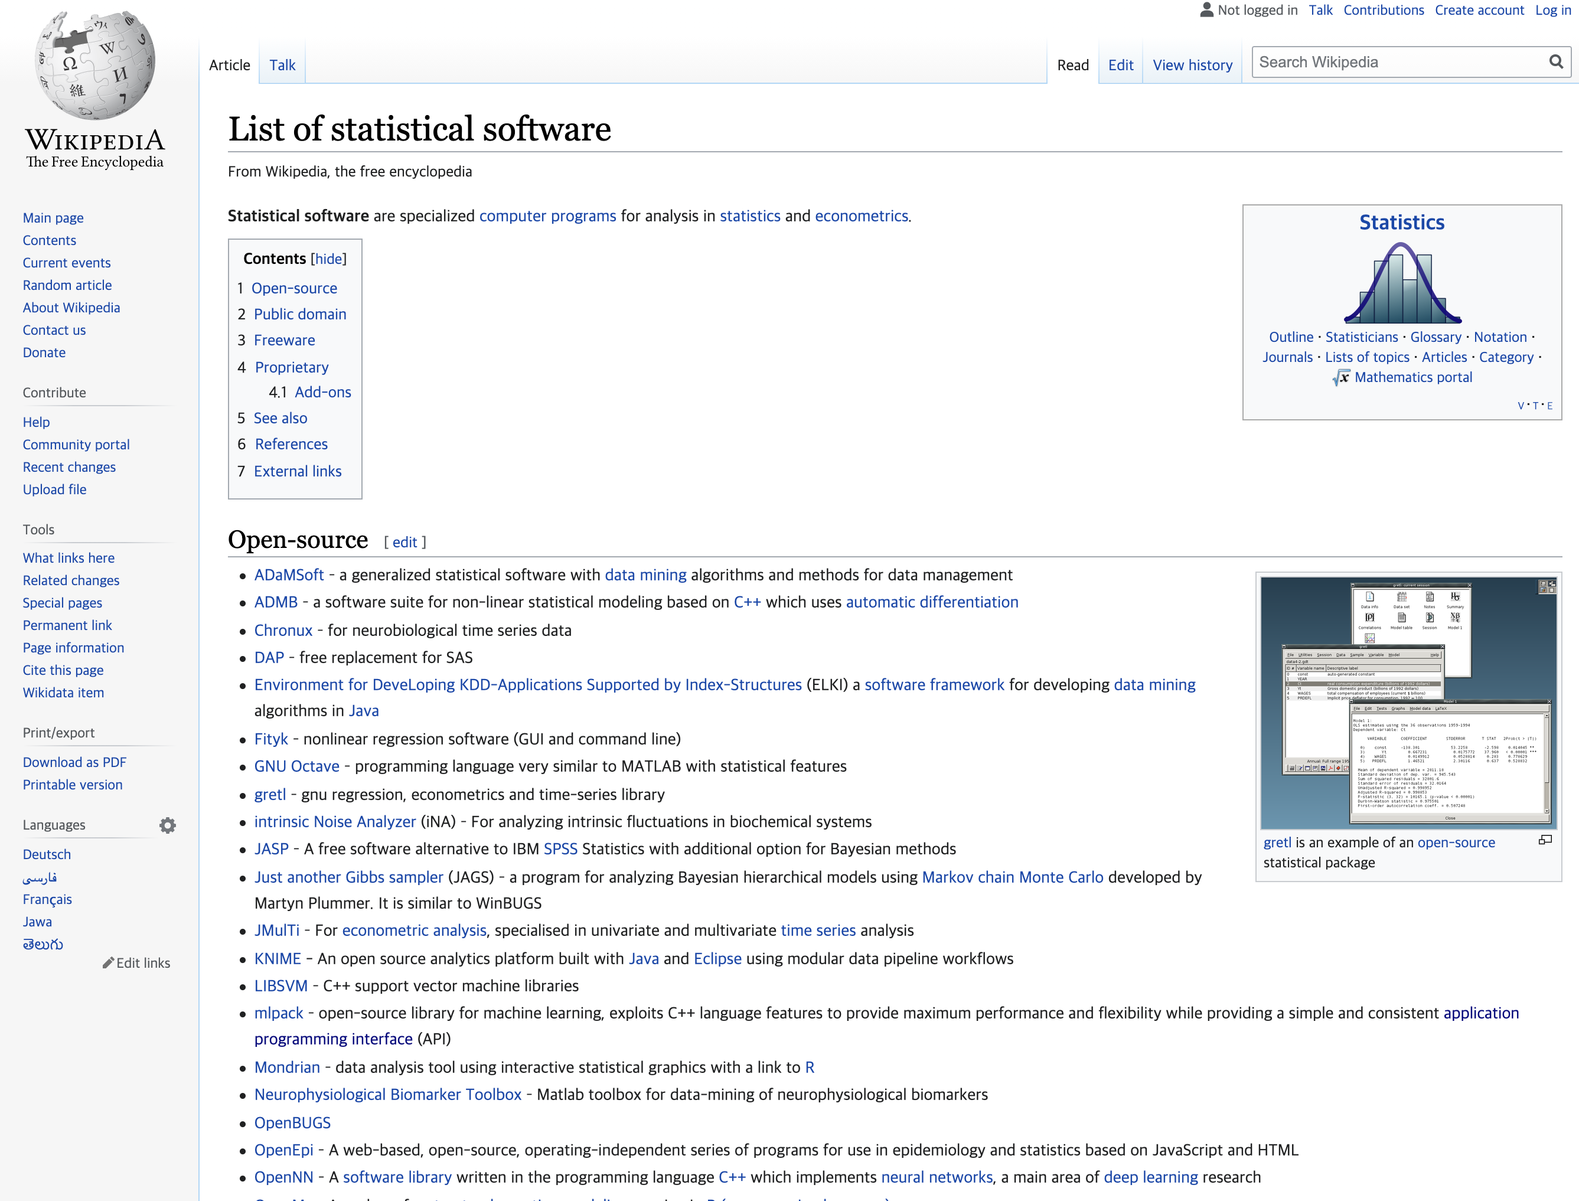
Lecture 13
Software packages for statistics
https://en.wikipedia.org/wiki/List_of_statistical_software
There are so many software packages for statistics
CHOONG-WAN WOO | COCOAN lab | http://cocoanlab.github.io

Slide 3





Lecture 13
The ones that I have used before…
and now…
OLDIES (that I am not using any more)
Basic statistics
SAS (during my undergrad)
SPSS (during my masters)
STATA (for my wife)
Multivariate
LISREL
Mplus
AMOS
What I am using now:
Basic statistics
Matlab
R
JASP
JAMOVI
Python
Multivariate
Matlab
Python
R
Open source
Cultural changes for the last 20 years
CHOONG-WAN WOO | COCOAN lab | http://cocoanlab.github.io

Slide 4

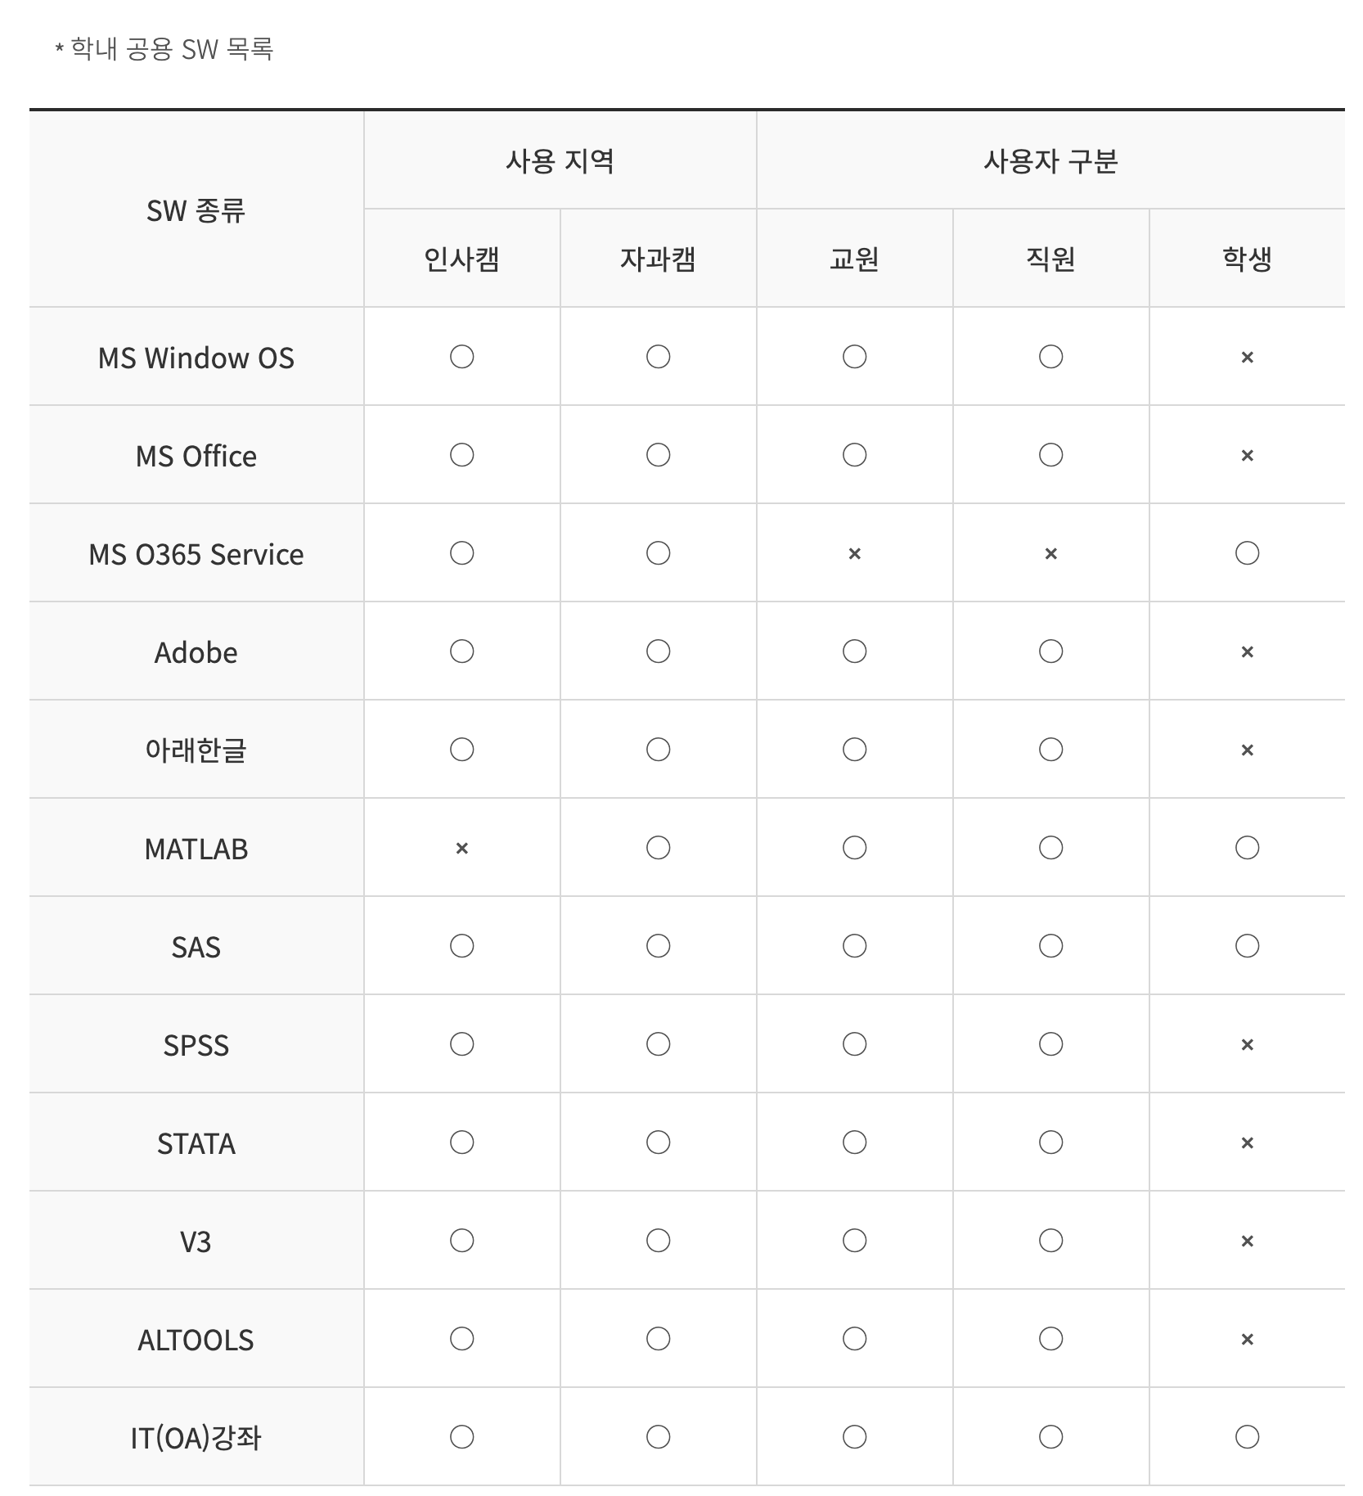
Lecture 13
The ones that I have used before…
and now…
at SKKU
OLDIES (that I am not using any more)
Basic statistics
SAS (during my undergrad)
SPSS (during my masters)
STATA (for my wife)
Multivariate
LISREL
Mplus
AMOS
What I am using now:
Basic statistics
Matlab
R
JASP
JAMOVI
Python
Multivariate
Matlab
Python
R
Open source
Cultural changes for the last 20 years
CHOONG-WAN WOO | COCOAN lab | http://cocoanlab.github.io

Slide 5
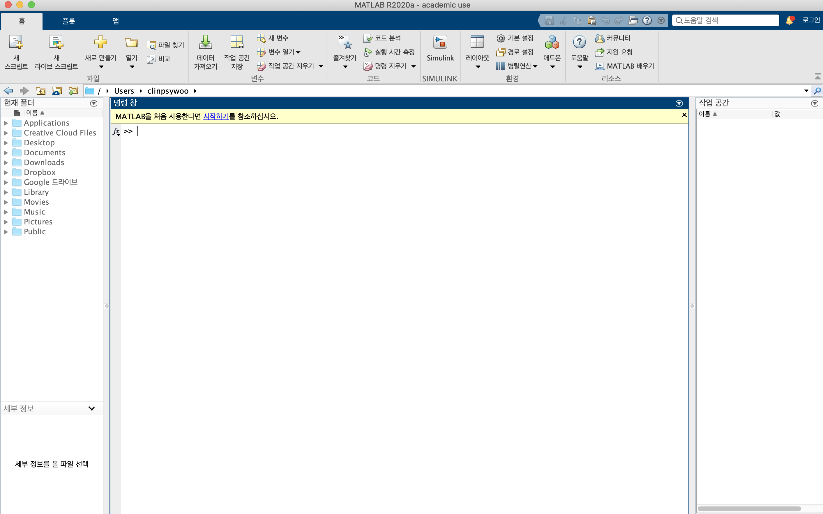

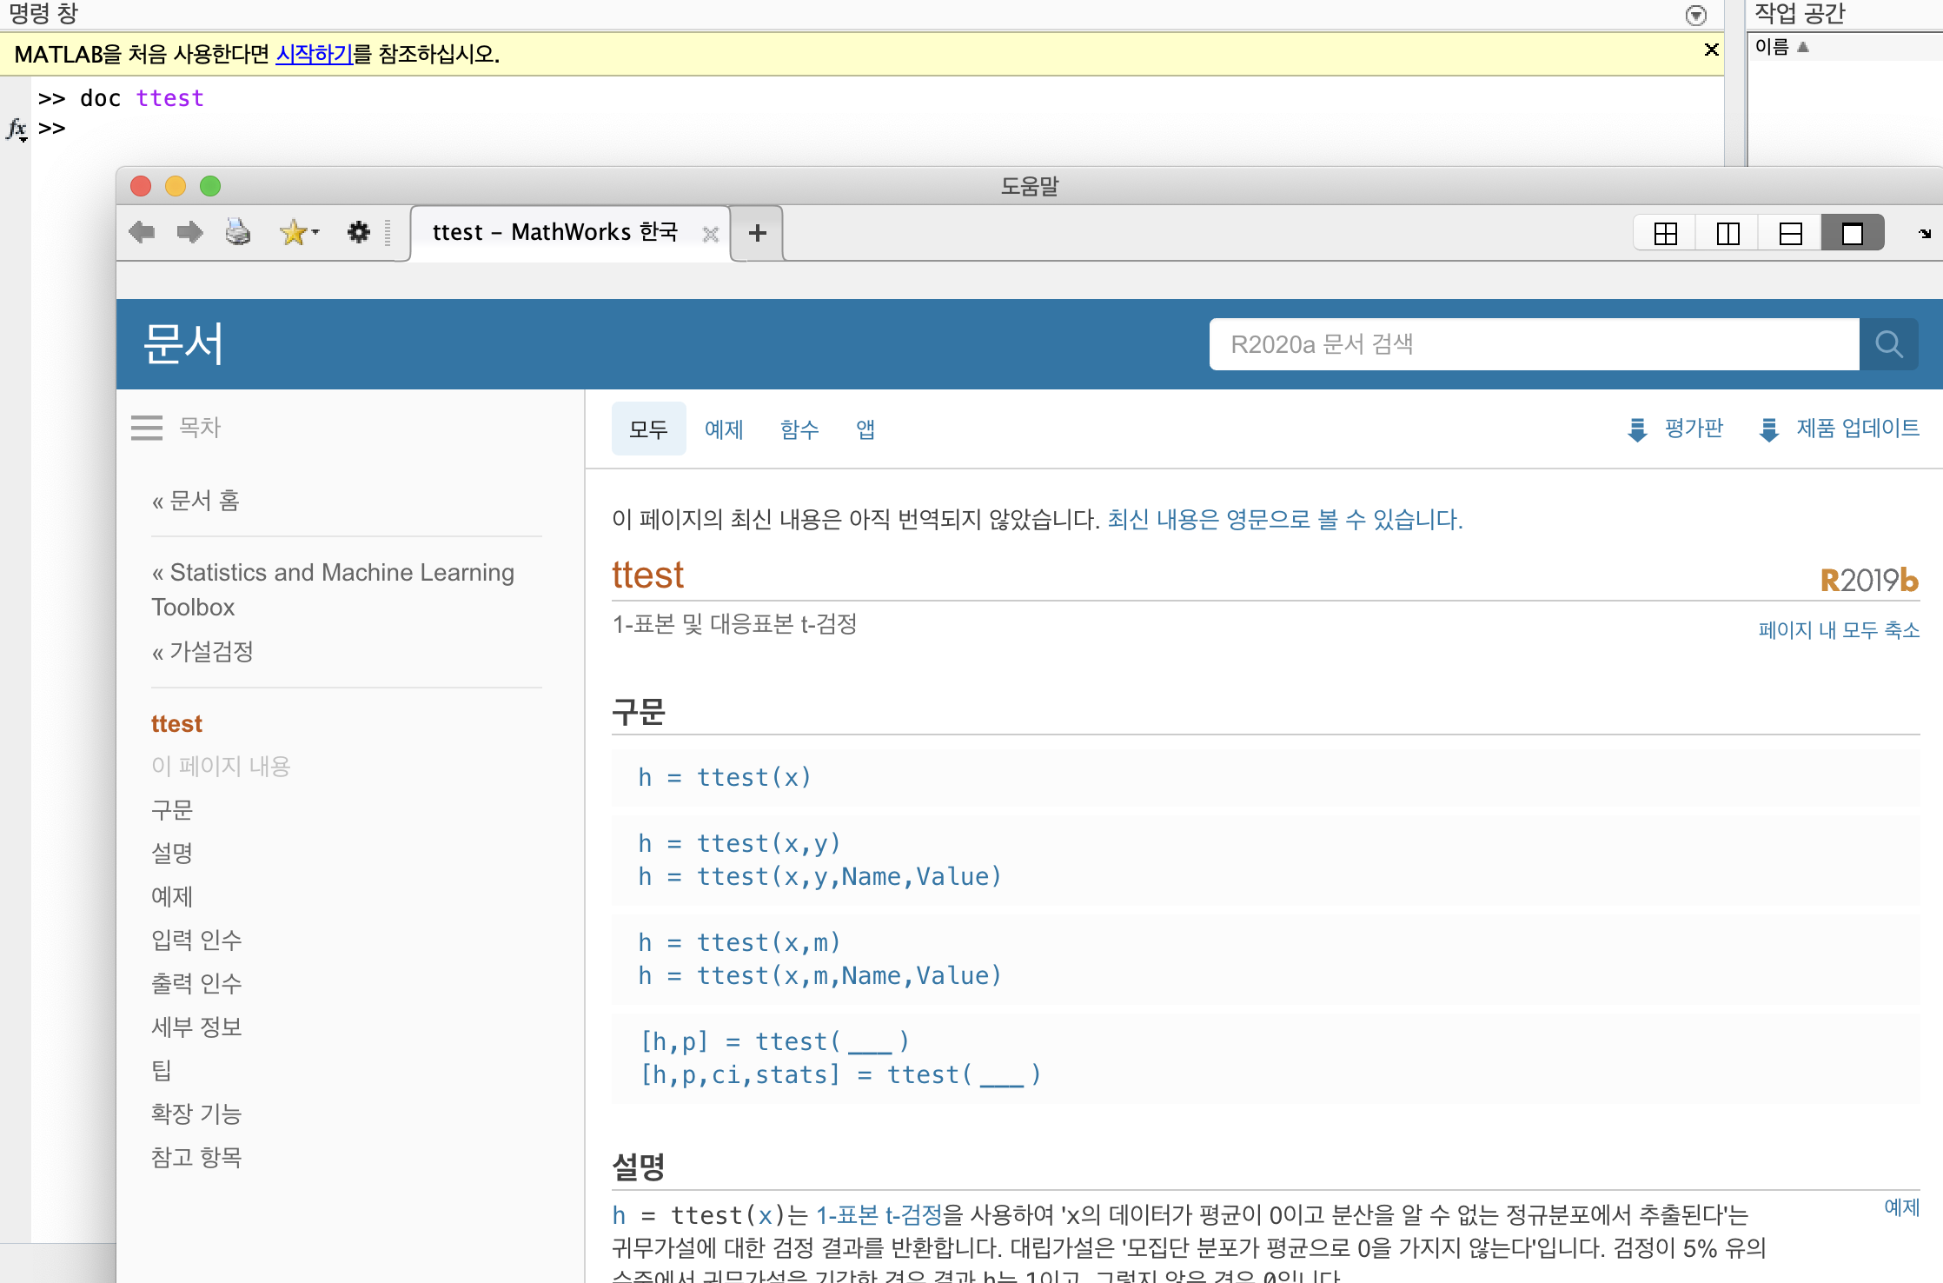
Lecture 13
Matlab
CHOONG-WAN WOO | COCOAN lab | http://cocoanlab.github.io

Slide 6
Lecture 13
Matlab
Strengths:
Command line coding
Simple and fast
Well-developed toolboxes (e.g., statistics and machine learning toolbox)
Open source tools for neuroimaging and others (thick user base)
Weaknesses:
Expensive (what if you graduate the school?)
The popularity is decreasing (the user base is getting weaker)
Deep learning?
CHOONG-WAN WOO | COCOAN lab | http://cocoanlab.github.io

Slide 7
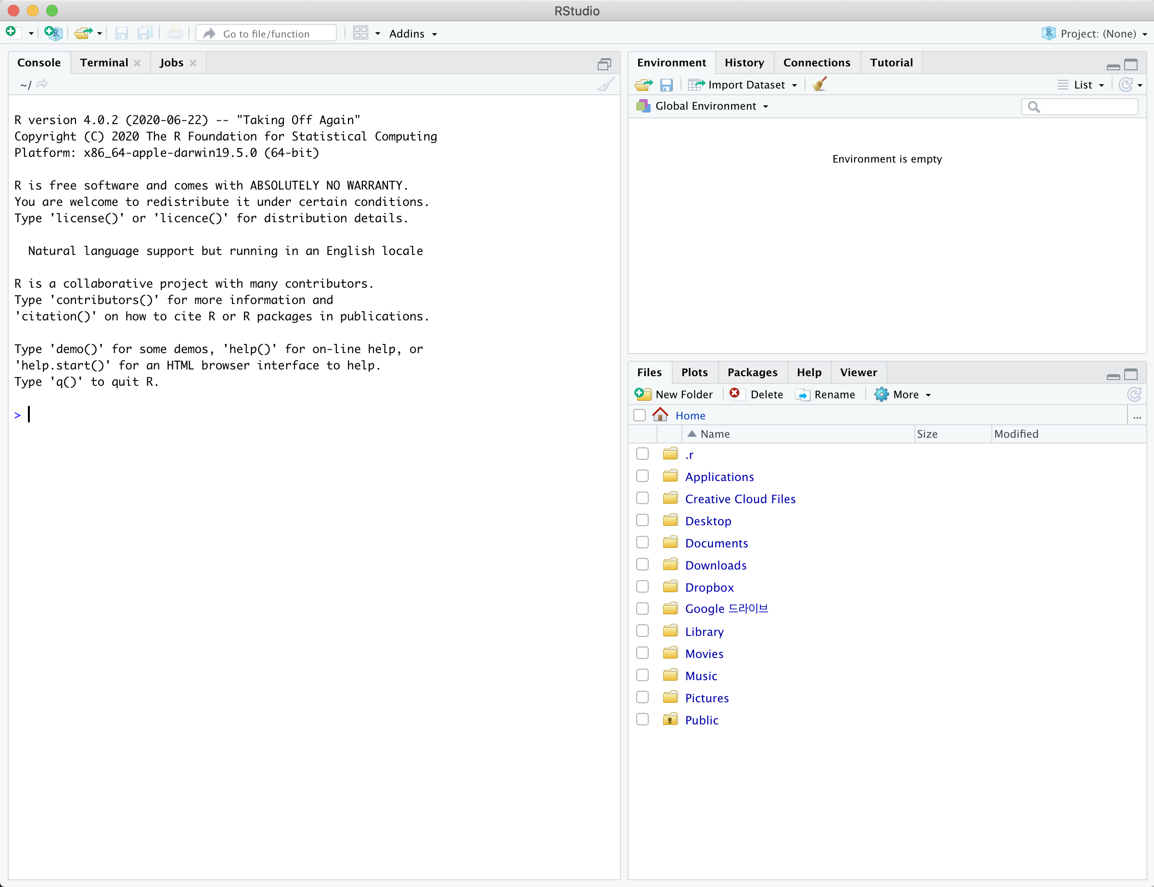
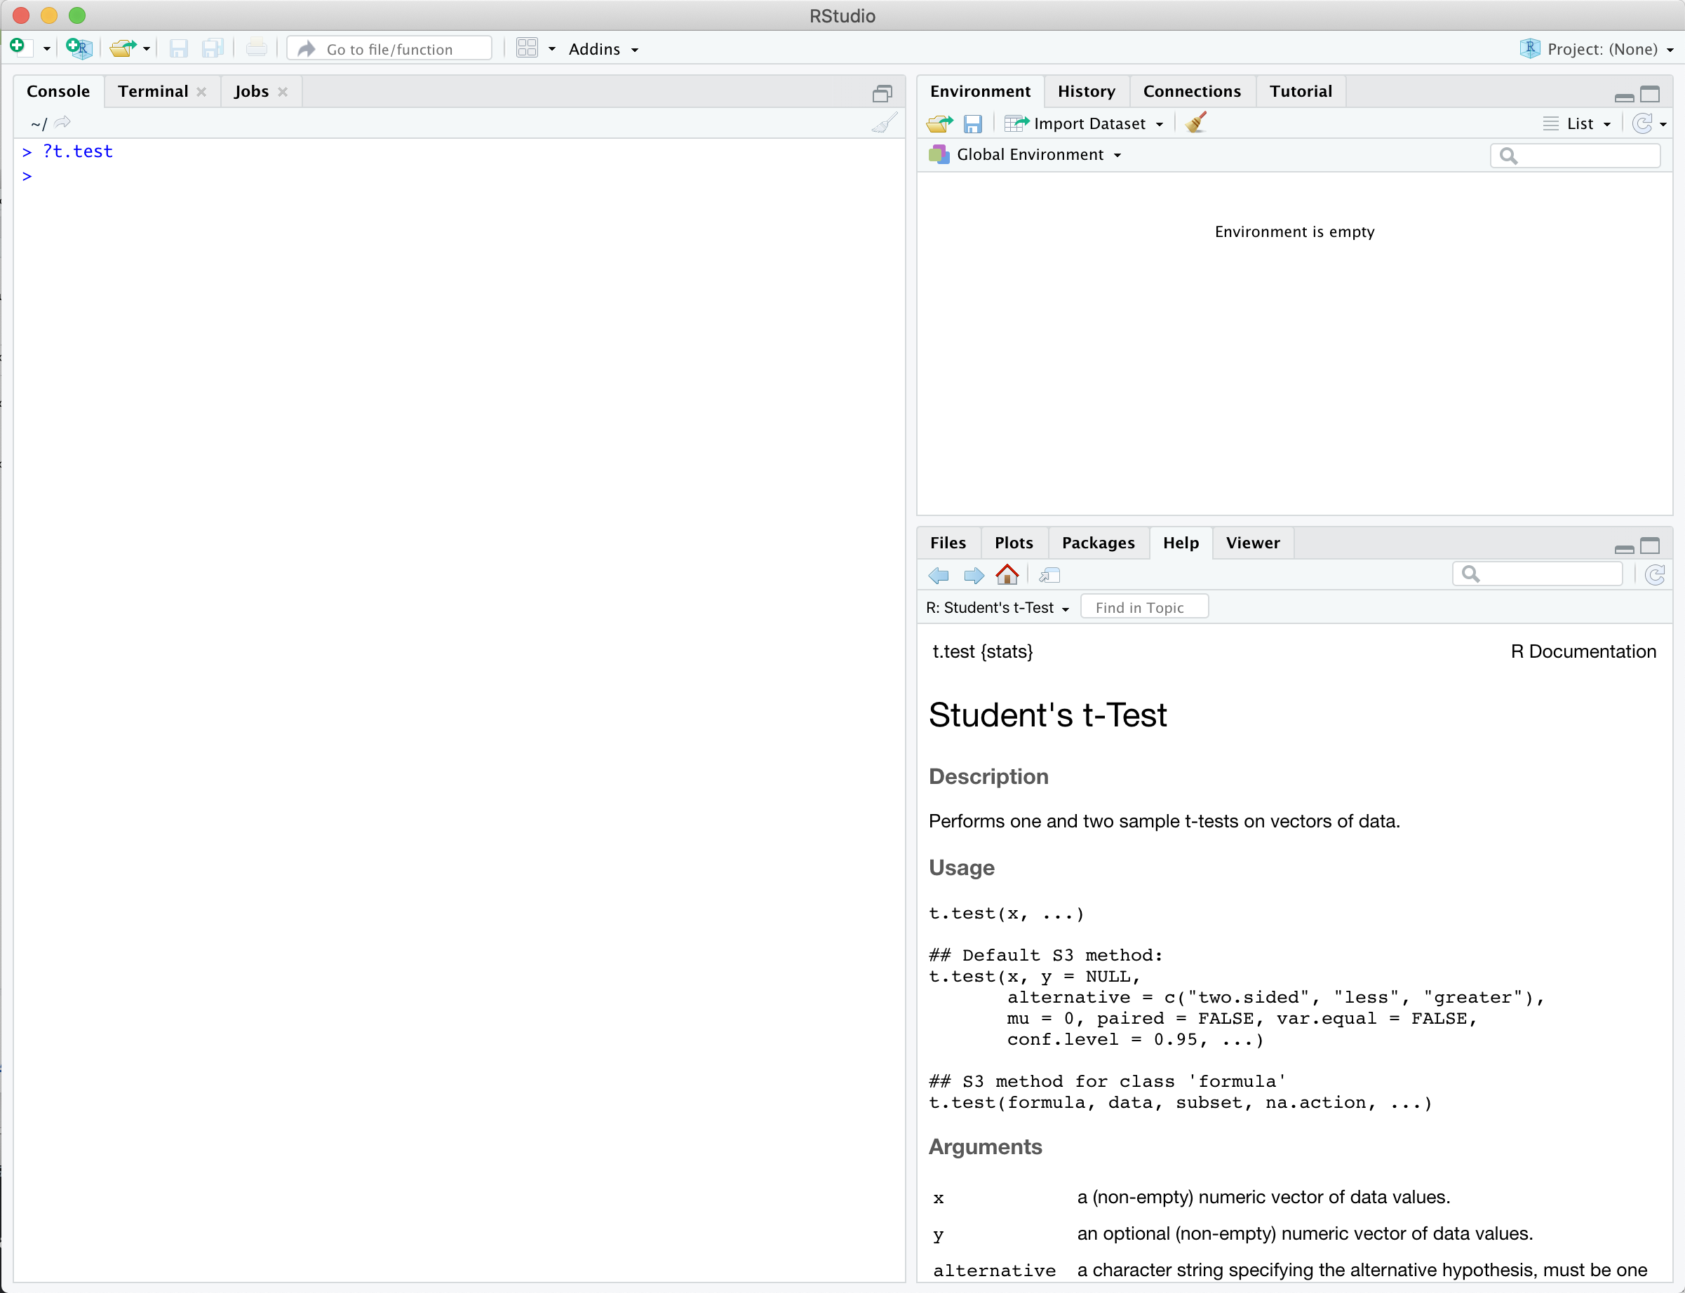
Lecture 13
R
CHOONG-WAN WOO | COCOAN lab | http://cocoanlab.github.io

Slide 8
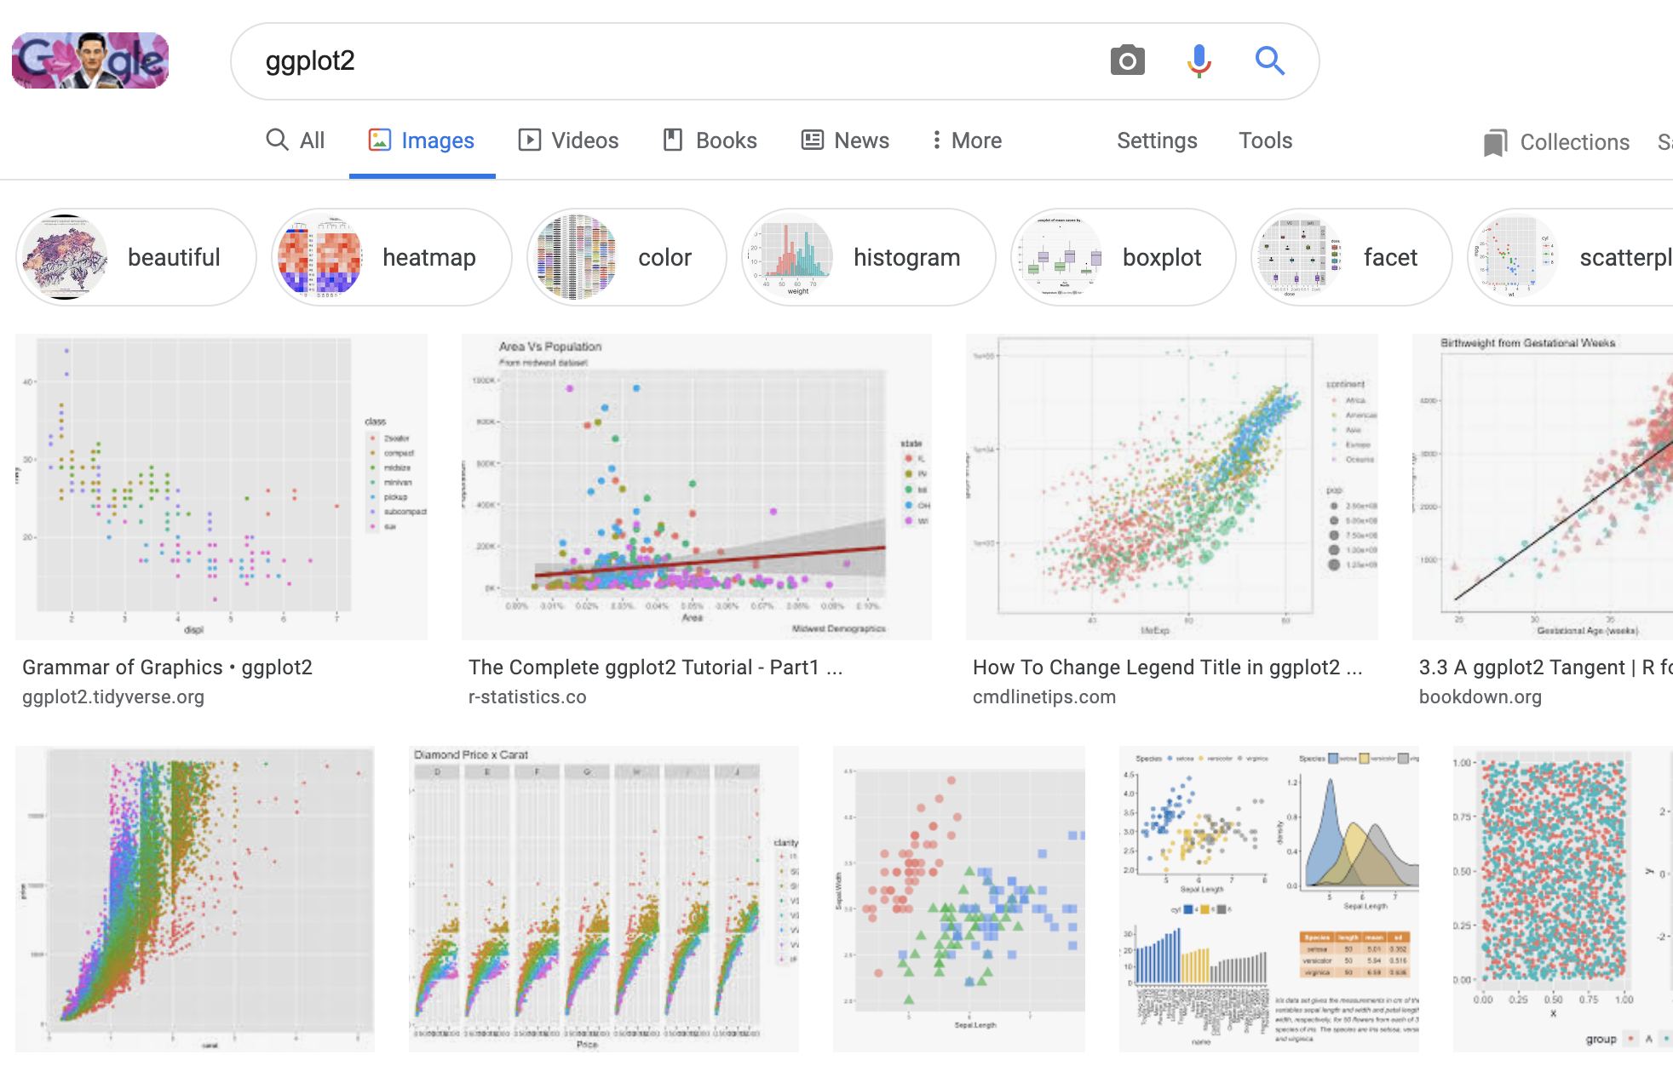
Lecture 13
R
Strengths:
Command line coding
Simple and fast
Thick user base!!! Esp. in statistics; so many useful packages for advanced stats
Good visualization tools (e.g., ggplot2)
The popularity is increasing
Weaknesses:
No good connection with neuroimaging
The popularity is lower than python
Deep learning?
CHOONG-WAN WOO | COCOAN lab | http://cocoanlab.github.io

Slide 9
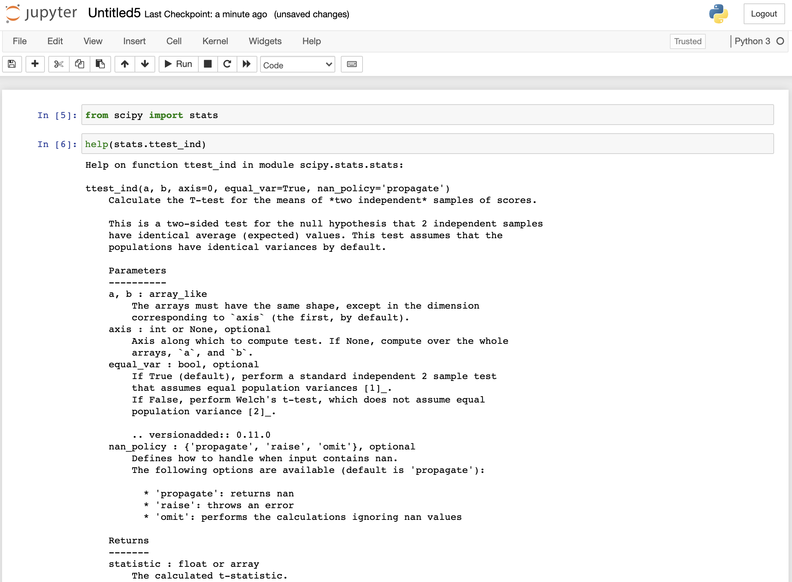
Lecture 13
Python
CHOONG-WAN WOO | COCOAN lab | http://cocoanlab.github.io

Slide 10
Lecture 13
Python
Strengths:
Command line coding
Simple and fast
Thick thick user base! Esp. in machine learning and others; so many useful packages for everything
Deep learning!
The popularity is rapidly increasing
Weaknesses:
Not really good for statistics (maybe compared to R or matlab), but still okay
CHOONG-WAN WOO | COCOAN lab | http://cocoanlab.github.io

Slide 11
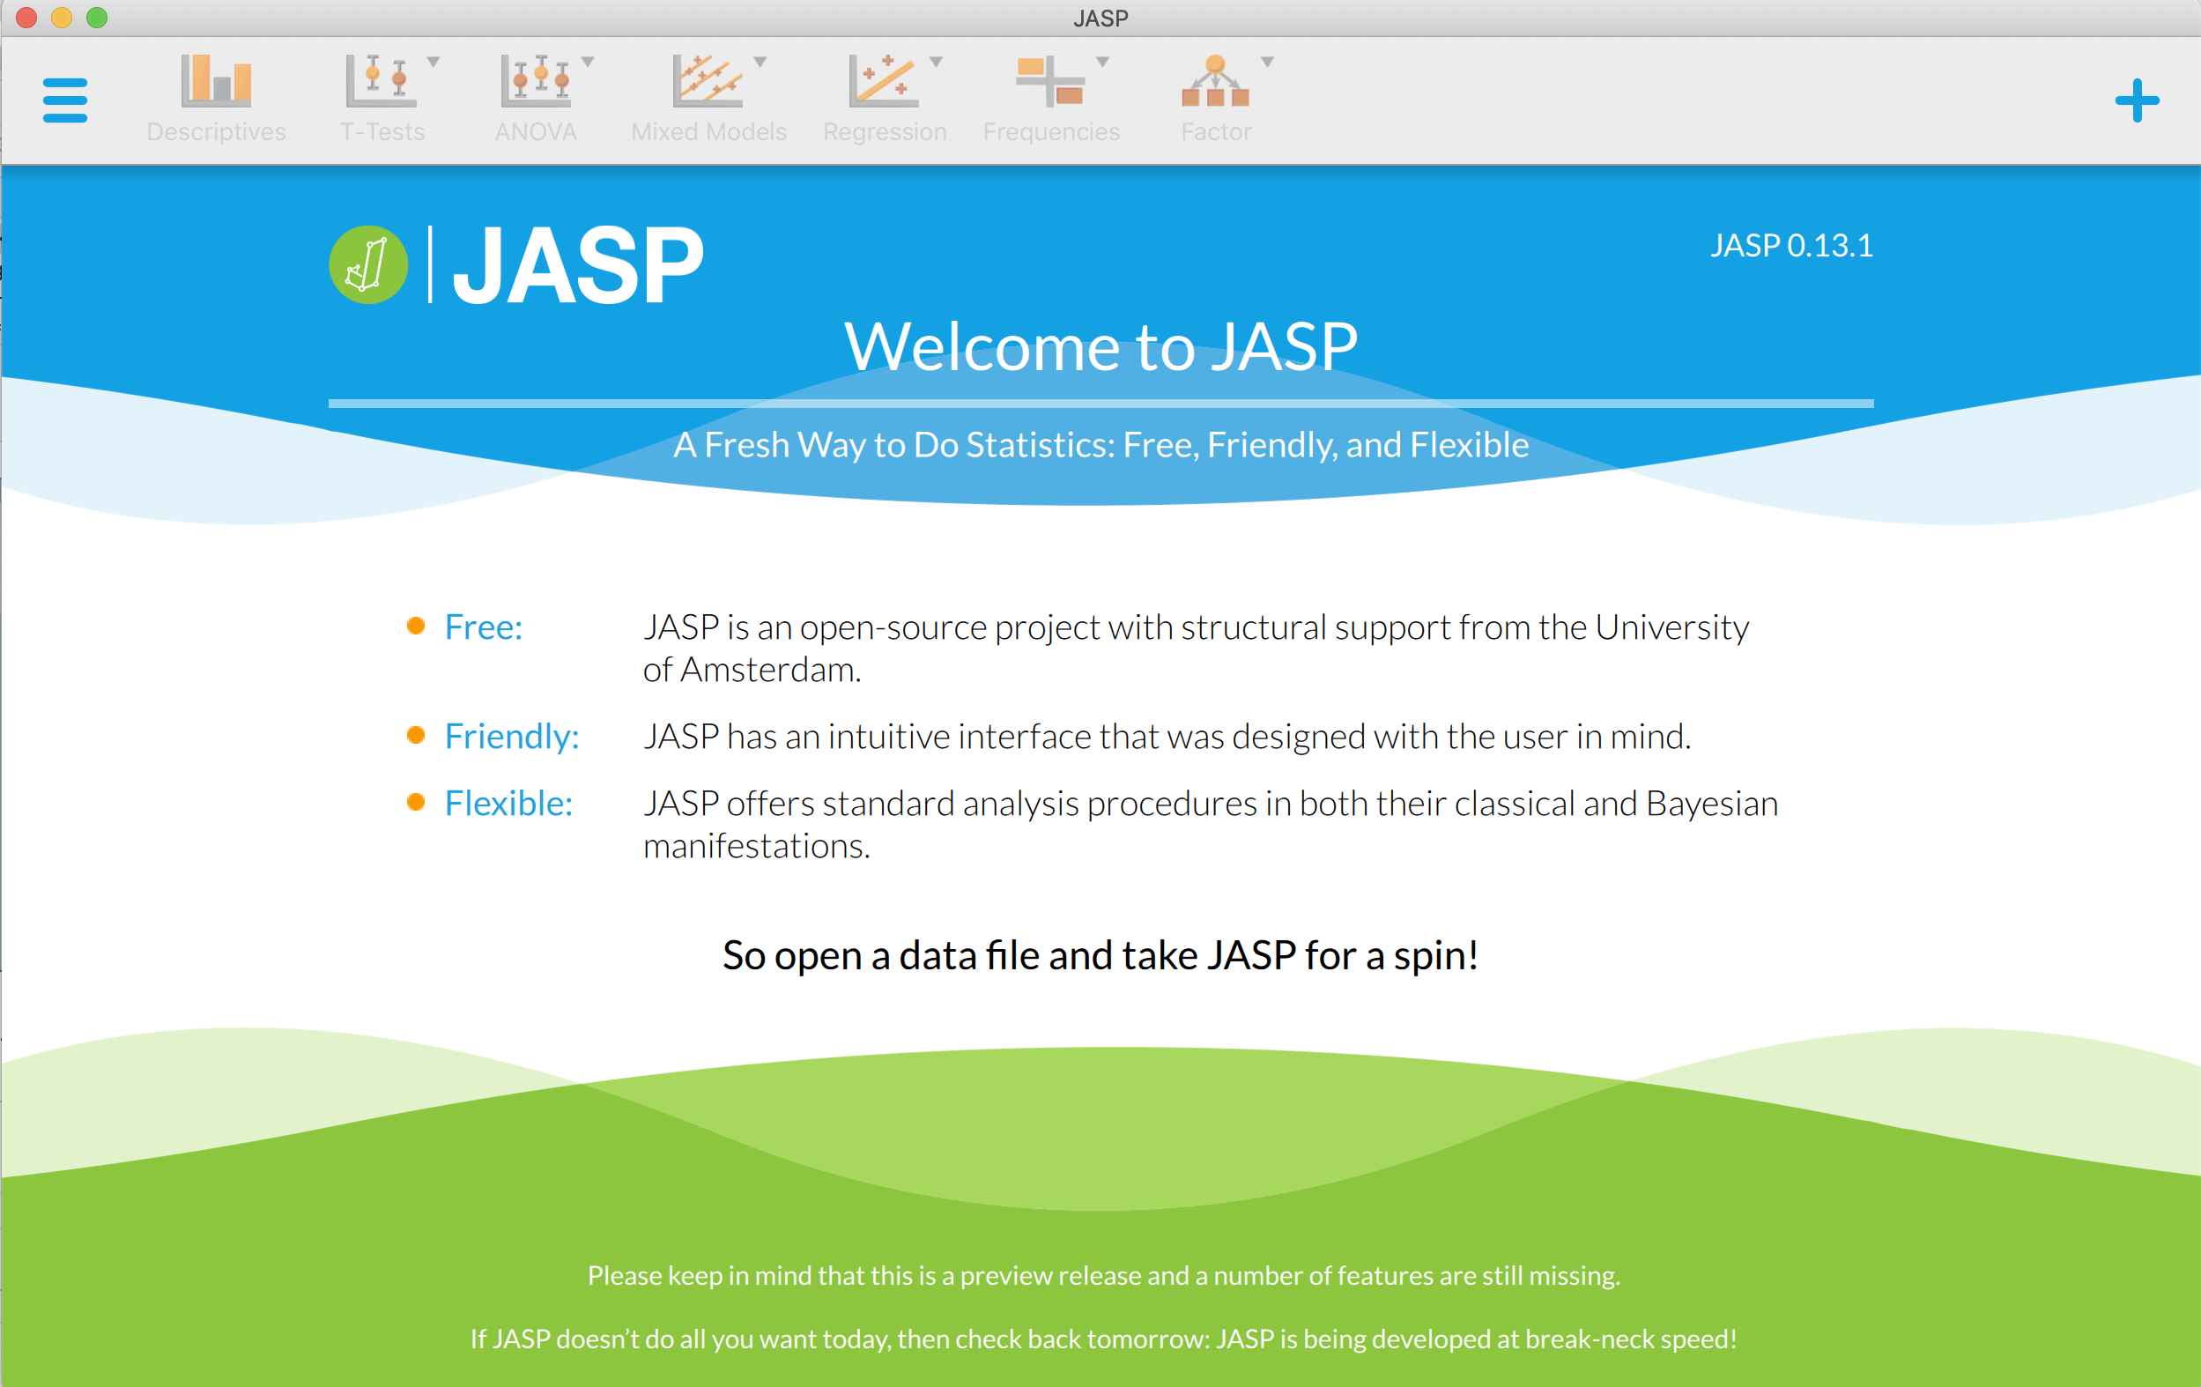
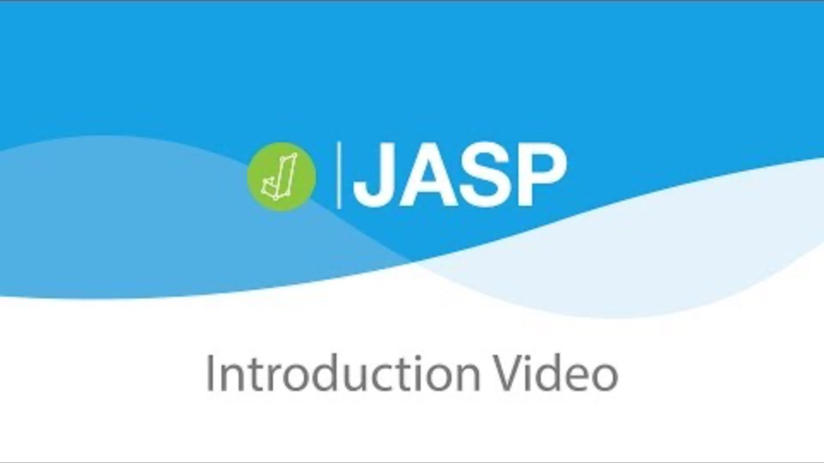
Lecture 13
JASP
https://jasp-stats.org/2017/06/27/new-5-minute-video-introducing-jasp/
CHOONG-WAN WOO | COCOAN lab | http://cocoanlab.github.io

Slide 12
Lecture 13
JASP
Strengths:
Free!
Graphical user interface
Simple and easy
Bayesian analysis
Weaknesses:
Not command line
No flexibility
No development
CHOONG-WAN WOO | COCOAN lab | http://cocoanlab.github.io

Slide 13
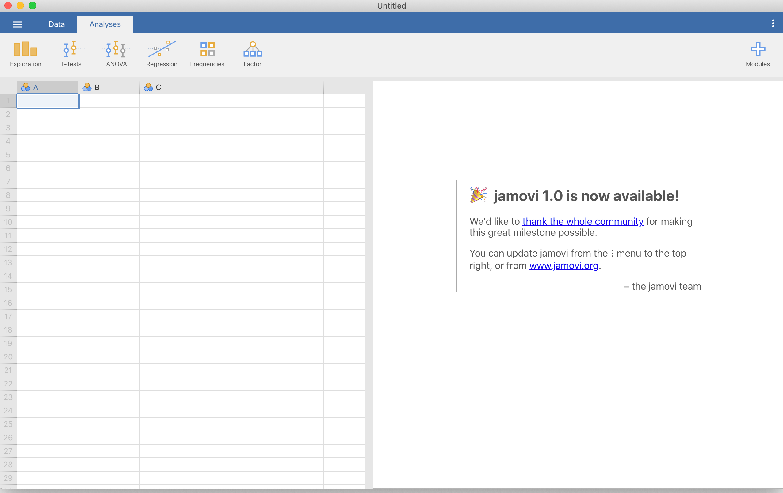

Lecture 13
JAMOVI
https://www.youtube.com/watch?v=Ej9e8lzaeDE&feature=emb_logo
CHOONG-WAN WOO | COCOAN lab | http://cocoanlab.github.io

Slide 14
Lecture 13
JAMOVI (similar to JASP)
Strengths:
Free!
Graphical user interface
Simple and easy
Bayesian analysis
Weaknesses:
Not command line
No flexibility
No development
Interestingly, JAMOVI was developed by the previously JASP developers.
http://blog.efpsa.org/2017/03/23/introducing-jamovi-free-and-open-statistical-software-combining-ease-of-use-with-the-power-of-r/
CHOONG-WAN WOO | COCOAN lab | http://cocoanlab.github.io

Slide 15
Lecture 13
Thus, our choice for the class is…
JAMOVI
(JASP)
Matlab
R
CHOONG-WAN WOO | COCOAN lab | http://cocoanlab.github.io

